Slide 1
"An Empirical Analysis of Returns and Volatility: A Case Study of Apple Stock Using OLS, ARIMA, and GARCH“ . Replication of “Forecasting Apple Inc. Stock Prices Using S&P500– An OLS Regression Approach with Structural Break” Trishit Banerjee Department of Basic Engineering and Sciences Netaji Subhash Engineering College Kolkata, India trishit.banerjee@nsec.ac.in
By Shatakshi Bansode
Student number: 24201471
Module: Financial Econometrics FIN41660
Academic Year: 2024/2025

Slide 2
1. Introduction
Objective: Analyze Apple’s daily stock returns from 2021 to 2023 using OLS, ARIMA, and GARCH models.
Purpose: Understand how sector-specific and market-wide factors impact Apple’s returns.
Research Focus:
Role of sector-specific drivers (S&P 500 IT index) on Apple's returns.
Modeling volatility clustering using GARCH(1,1).

Slide 3
2. Data Collection and Preparation
Data Sources:
Yahoo Finance: AAPL, S&P 500 (^GSPC), and S&P 500 IT index (XLK) daily data.
Time Period: January 2021 to December 2023.
Data Preparation:
Daily returns calculated for Apple, S&P 500, and S&P 500 IT index.
Sample Size: 752 observations.

Slide 4
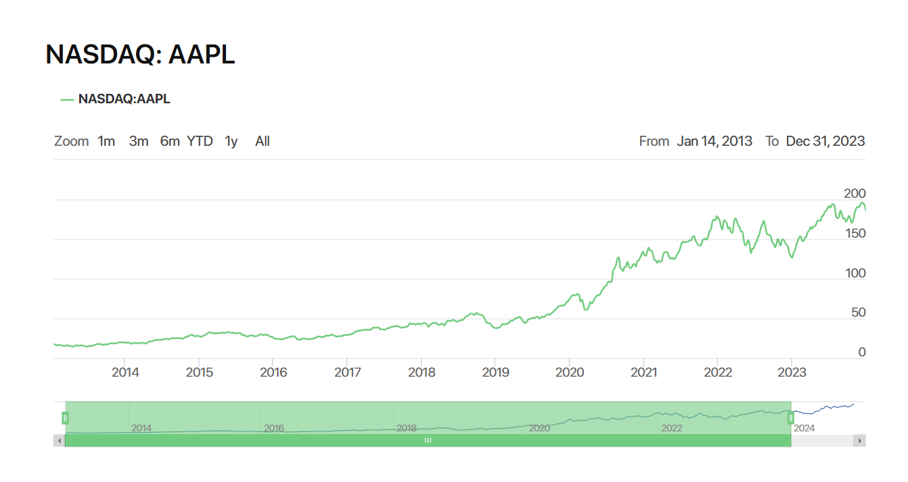
3. Exploratory Data Analysis
Graph: Show stock price trends for AAPL (2021–2023).
Insight: Large fluctuations in 2022 due to global factors (inflation, interest rates).

Slide 5
4. Methodology Overview
OLS (Ordinary Least Squares): Identify relationships between Apple’s returns, S&P 500, and S&P 500 IT returns.
ARIMA (Autoregressive Integrated Moving Average): Ensure residuals are white noise.
GARCH (Generalized Autoregressive Conditional Heteroskedasticity): Model volatility clustering in returns.

Slide 6
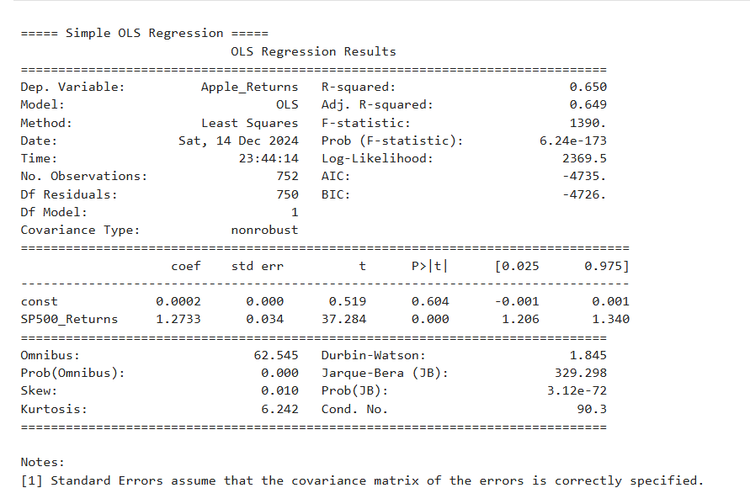
5. OLS Regression Model
Simple regression equation:
Apple Returns = α + β₁(SP500 Returns) + β₂(SP500 IT Returns) + ϵ
Key Results:SP500 Coefficient: −0.1446 (not significant, p = 0.062).
SP500 IT Coefficient: 1.0908 (significant, p < 0.001).
R-squared = 0.768 (76.8% of Apple’s returns explained).

Slide 7
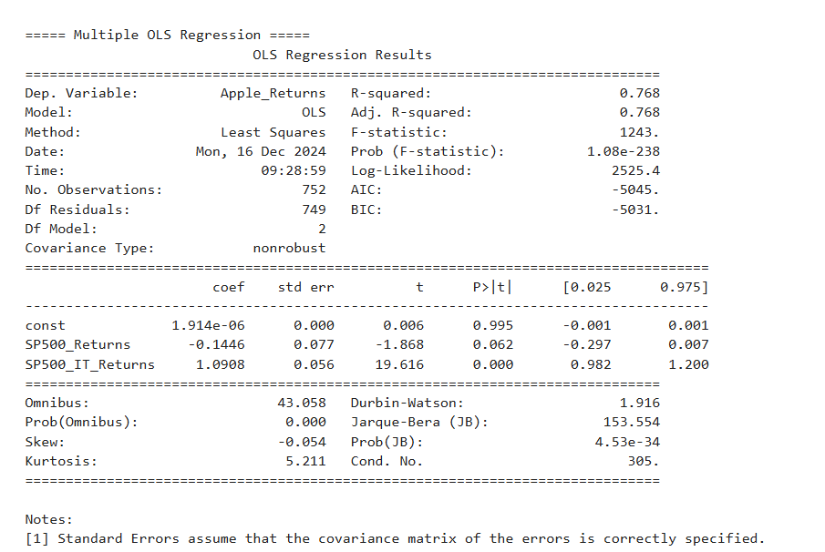

5.1 Multiple OLS regression
Simple regression equation:
$Apple_{Returns}=β0​+β1​⋅SP{500}_{Returns}+β2​⋅SP{500}_{IT_{Returns}}+ε$
S&P 500 Returns Coefficient: This variable's coefficient was found to be insignificant (p > 0.05) in the multiple regression model, unlike in the simple regression. This suggests that when the influence of the S&P 500 IT sector is considered, the direct impact of the overall S&P 500 index on Apple’s returns diminishes.

Slide 8
6. Residual Diagnostics
Tests Conducted:
Jarque-Bera Test: Residuals are not normally distributed (p < 0.05).
Breusch-Pagan Test: Detected heteroskedasticity (variance of residuals is not constant).
Durbin-Watson Test: No autocorrelation (DW = 1.92, close to 2).
Action Taken: Applied HAC (heteroskedasticity and autocorrelation consistent) robust standard errors.

Slide 9
7. ARIMA Model
Purpose: Check for autocorrelation and white noise in residuals.
Model Used: ARIMA(1,0,1) based on AIC and BIC criteria.
Key Parameters:
AR(1) Coefficient = -0.4508 (not significant).
MA(1) Coefficient = 0.4976 (not significant).
Diagnostic Tests: Ljung-Box Q-statistic: Residuals are white noise (p > 0.05).
Conclusion: ARIMA confirms no further pattern in residuals.

Slide 10
8. GARCH Model
Why GARCH?
Financial returns exhibit volatility clustering.
Large shocks are often followed by more large shocks.
GARCH(1,1) Model:
σ²ₐₐ = ω + αε²ₐₑₛₐ + βσ²ₐₑ
Results:
ω (constant variance) = 0.0257 (significant, p < 0.05).
α (ARCH effect) = 0.0018 (not significant).
β (GARCH effect) = 0.9599 (significant, large persistence).
Conclusion: Strong volatility persistence as β is close to 1.

Slide 11
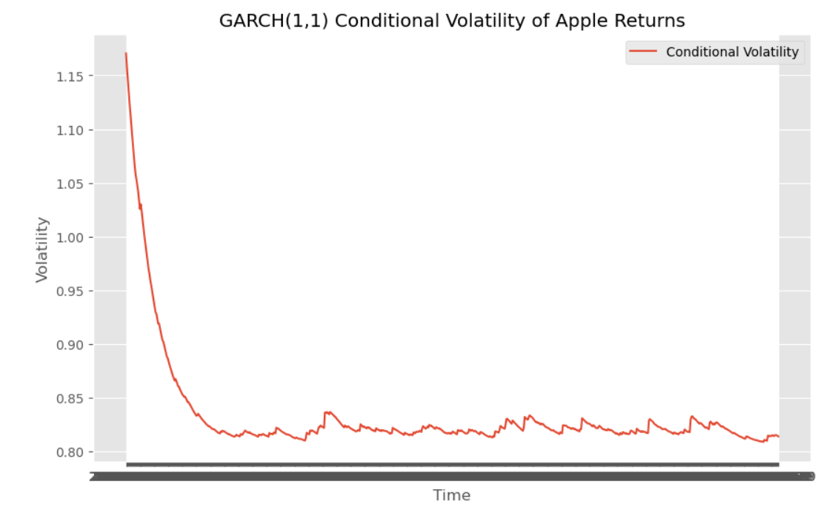
9. Conditional Volatility Plot
Graph: conditional volatility from GARCH(1,1).
High volatility is seen in 2022 due to market turbulence from inflation and interest rate hikes.

Slide 12
10. Results
Dominant positive influence on Apple’s returns, while the broader S&P 500 index shows a weaker and statistically insignificant effect. The ARIMA model validated that no autocorrelation remained in the residuals, confirming the robustness of the OLS results. The GARCH(1,1) model highlighted volatility clustering and persistent volatility, with periods of high volatility aligning with market shocks. These findings emphasize the importance of sector-specific trends in explaining Apple’s returns and the need for robust risk management strategies in volatile market conditions.
Model | R-squared | AIC | BIC | Volatility Insights
OLS | 0.650 | -5044.76 | -5030.90 | No volatility captured
ARIMA | - | -5044.563 | -5026.072 | Residuals = white noise
GARCH(1,1) | - | 1872 | 1891 | Volatility persistence
Although the GARCH model has higher AIC and BIC values than other models, with an AIC of 1872 and a BIC of 1891, this is not necessarily a weakness. GARCH is explicitly designed to model volatility clustering, which neither OLS nor ARIMA can achieve. The higher AIC and BIC are simply a natural result of the model's complexity and the nature of volatility modeling.

Slide 13
11. Conclusion
The results proved that this IT sector index had a significant positive influence on the return of Apple, underlining that sector-specific performance is of relevance to driving individual stock behaviours. However, S&P 500 index returns did show insignificant or a little negative relationship in multiple regression. High R-square values suggested that the selected independent variables explained a significant portion of the variability in the returns of Apple.
OLS: S&P 500 IT returns are the most influential on Apple’s returns.
ARIMA: Validates that no further pattern exists in residuals.
GARCH: Captures volatility clustering, showing persistent periods of high and low volatility.

Slide 14
THANK YOU

